Slide 1
Financial Markets and Securities Options Market
Notes:
Introduction:

Slide 2
Derivatives
Derivative securities
Payoffs that depend on the values of other underlying assets
Index, Stock, Gold, Currency, Corn, Coffee, etc.
Futures, Options
The distinguishing characteristic of derivatives is the leverage they offer. The value of a position, which a derivative represents is far greater than the down payment made by the trader. This leverage makes derivatives cost effective in a positive sense and risky in a negative sense.

Slide 3
Derivative Instruments
Forward contracts (Forwards)
Futures contract (Futures)
Options
Swaps
Remember: The underlying assets of these derivatives can be: currency, commodity, stocks, etc.

Slide 4
What is Option?
Non-symetric obligations and rights for buyer and for seller
To buyer: Option gives the right (but not the obligation) to buy (in case of a call) or sell (in case of a put) the given financial asset at a given date for a given (exercise ) price
To seller: Option represents an obligation to sell (or buy) the given financial asset at a given date for a given price, if the option buyer asks the execution of the deal!

Slide 5
PARAMETERS OF OPTIONS
Exercise price = strike price = price at which the holder of the option can exercise the option (and thus buy or sell the underlying asset)
Expiration date
Premium = amount paid for the option
American option: can exercise any time up to and including expiration date
European option: can exercise only on expiration date

Slide 6
Option Characteristics
If a call option holder wishes to purchase the stock, he or she will exercise the option. The option holder must pay the exercise price to the option writer.
Exercise prices are adjusted for stock splits and stock dividends, but not cash dividends.
The cost of an option is called the premium and it is a small percentage of the cost of the underlying asset. The option buyer pays the cost; the option writer receives the cost at the time of sale of the option.
The underlying company is not involved in the option market.
Options are a zero sum game.
Notes:
When we buy options?

Slide 7
Option Terminology
What is a listed call option?
A contract giving the holder the right (but not the obligation) to buy 100 shares of stock at a preagreed price called the exercise or strike price.
What is a listed Put option?
A contract giving the holder the right to sell 100 shares of stock at a preagreed price
Uses of options:
To hedge changes in stock price.
Change your risk and return profile
For example, buying a call is analogous to buying stock on margin.
Short sale constraints can be avoided with puts.
Notes:
(Friday is the last day you can exercise)

Slide 8
Types of Options
From transaction point of view:
Long Call (buy/own/have a buy opportunity)– Short Call (sell a buy opportunity, this is a sell obligation)
Long Put (buy/have a sell opportunity)– Short Put (sell a sell opportunity, this is a buy obligation)
From exercise point of view:
the option can be exercised at any date after purchase.
American:
European:
Option market: Which gives more right?
Why it is usefull?
the option can only be exercised immediately before expiration
Notes:
European: Only on that last Friday.
Which gives more right? EU or US?

Slide 9
Options value: Payoff Charts
Payoff
Long Call -- position
Short Call -- position
Long Put -- position
ShortPut -- position
S_{T}
X

Slide 10
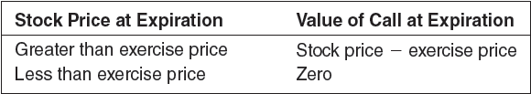
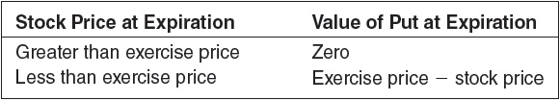
Option Value
Option Value: The value of an option at expiration is a function of the stock price and the exercise price.
Call Option
Put Option
Notes:
7
Option Value: The value of an option at expiration is a function of the stock price and the exercise price.

Slide 11
Option book on IBM

Slide 12
Listed Options
Index option:
Futures option: give their holders the right to buy or sell a specified futures contract, using as a futures price the exercise price of the option
Foreign currency options: right to buy or sell a quantity of foreign currency for a specified amount of domestic currency.
Interest rate options:
Notes:
Covered or exposed: A covered call writer can post the stock to satisfy the margin requirement, a naked call writer must post cash.

Slide 13
Bull and Bear strategies
Long Call: Bullish
Long Put: Bearish
Short Call: Bearish (obligation to sell)
Short Put: Bullish (obligation to buy)
In the Money: exercise of the option would be profitable
Call: market price > exercise price
Put: exercise price > market price
Out of the Money:exercise of the option would not be profitable
Call: market price < exercise price
Put: exercise price < market price
At the Money: exercise price and asset price are equal
Why can be option more attractive than to B/S the underling shares?
Notes:
Covered or exposed: A covered call wri
This simple example makes an important point. While options can be used by speculators as effectively leveraged stock positions, as in portfolio B, they also can be used by investors who desire to tailor their risk exposures in creative ways, as in portfolio C. For example, the call plus T-bills strategy of portfolio C provides a rate of return profile quite unlike that of the stock alone. The absolute limitation on downside risk is a novel and attractive feature of this strategy. In the next section we will discuss several option strategies that provide other novel risk profiles that might be attractive to hedgers and other investors.ter can post the stock to satisfy the margin requirement, a naked call writer must post cash.

Slide 14
Values of Options at Expiration

Slide 15

Option Terminology
>
>
>
>
Both are “at the money” when?
Symbols & Valuation
C_{t} = Price paid for a call option at time t. t = 0 is today,
T = Immediately before the option's expiration.
P_{t} = Price paid for a put option at time t.
S_{t} = Stock price at time t.
X = Exercise or Strike Price
A call is “in the money” if S_{t} ____ X.
A call is “out of the money” if S_{t} ____ X.
A put is “in the money” if S_{t} ____ X.
A put is “out of the money” if S_{t} ____ X.
Notes:
An option is in the money if you could profitably exercise it right now.

Slide 16
Basics of Option Pricing
6. The basics of option pricing
a) Price boundaries
Just before expiration at time T:
If S_{T} < X then if S_{T} > X then
C_{t} ≥ 0, Why?
P_{t} ≥ 0
P_{t} ≥ X - S_{t}
C_{t} ≥ S_{t} – X, Why?
$5 $60 $50
If C_{t} < S_{t} – X How could you take advantage of this?
Thus C_{t} ≥ Max (0, S_{t} – X)
P_{t} ≥ Max (0, X – S_{t})
C_{T} = 0
C_{T} = S_{T} – X

Slide 17
Profit at expiration from buying a call option
7. Option strategies and profits at expiration
Long Call – having a buy opportunity
BUYING A CALL
Profit Table
S_{T} < X
S_{T} > X
_{beginning}
– C₀
– C₀
end
0
S_{T} – X
= Profit
– C₀
– C₀ + S_{T} – X
Breakeven
S_{T} = X + C₀
If the market price is lower than our exercise price we will not exercise our option, therefor our result of the transaction is the loss of the option premium
If the market price is higher than our exercise price, it could be logical exercise our option, therefor our profit is profit between exercise price and maket price, minus the option premium
Notes:
Constructing a profit table is an excellent method to model and understand the payoffs of any option strategy. This is an excellent teaching tool. It is set up with the animation so that you can ask students to fill in the blanks. After the table is complete it is very easy to see the way the profit graph should look.

Slide 18
Call profit at expiration
Profit
OTM
ITM
B.E.: S_{T} = X + C₀
$100
Stock Price_{T}
$0
$92.65
$107.35
-C₀ + S_{T} – X
-C₀
-$735
Ex = $100
IBM Jul 100 call option
Stock Price = $96.14
Exercise = $100
Call premium = $735 or 7.35/sh
Contract Size 100 shares
Bullish or bearish?
High or low volatility strategy?
Notes:
The breakeven can be found: $100 + $7.35 = $107.35,
Buying this option is placing a bet that the stock price will climb above $107.35 by July
Bullish, & High volatility (see the Instructor’s Manual for more detail)

Slide 19


Writing a naked call
Profit
ITM
OTM
+C₀
+C₀ – S_{T} + X
Stock Price_{T}
$0
B.E.: S_{T} = X + C₀
X
Bullish or bearish?
High or low volatility strategy?
Notes:
Bearish; Low Volatility

Slide 20
Writing a naked call
Sort Call – sell (write) a buy opportunity.
This is an obligation to sell!
WRITING A NAKED CALL
Profit Table
S_{T} < X
S_{T} > X
+C₀
+C₀
+C₀
– C_{T}
0
–(S_{T} – X)
= Profit
+C₀
+C₀ – S_{T} + X
Breakeven
S_{T} = X + C₀
If the market price is lower than our exercise price the option wil not be exercised (buy the owner/buyer), therefor our profit equals the option premium
If the market price is higher than our exercise price, the owner of most probably will exercise our option, therefor our loss is the unralized loss between exercise price and maket price, minus the option premium

Slide 21
Buying a put option
Profit
Short position in IBM
IBM Dec 100 put option
Stock price = $96.14
Exercise = $100
Put premium = $1,166
Contract Size 100 shares
$8,834
X – S_{T} – P₀
$100
Stock Price_{t}
$0
$88.34
$111.66
– P₀
-$1,166
B.E.: S_{T} = X – P₀
Ex = $100
Put
ITM
OTM
Bullish or bearish? Alternative Stock Strategy?
High or low volatility strategy?
Notes:
21
Breakeven can be found as: $100 – $11.66 = $88.34
Bearish, High Volatility
Maximum gain is found as 100 shares x $100 = $10,000 - $1,166 option cost = $8,834

Slide 22
Buying a put option
Long Put – having (buying) a sell opportunity
BUYING A PUT
Profit Table
S_{T} < X
S_{T} > X
– P₀
– P₀
– P₀
+P_{T}
X – S_{T}
0
= Profit
X – S_{T} – P₀
– P₀
Breakeven
S_{T} = X – P₀
If the market price is higher than our exercise price, it could be not logical exercise our option, therefor our loss will be the (paid) option premium
If the market price is lower than our exercise price we will exercise our option, therefor our result is the profit between exercise price and maket price, minus the option premium (paid out)

Slide 23
Writing a put option
Profit
OTM
ITM
$1,166
S_{T} – X + P₀
+P₀
Stock Price_{t}
$0
$88.34
$100
$111.66
Long Position in IBM
Xx = $100
IBM Jul 100 put option
Stock price = $96.14
Exercise = $100
Put premium = $1,166
Contract Size 100 shares
- $8,834
Bullish or bearish? Alternative Stock Strategy?
High or low volatility strategy?
Notes:
Breakeven can be found as: $100 – $11.66 = $88.34
Bullish; Low Volatility, Max gain $1,166 but Max loss $8,834

Slide 24
Writing a put option
Short Put – sell (write) a sell opportunity.
This is an obligation to buy!
Writing A Put
Profit Table
S_{T} < X
S_{T} > X
+P₀
+P₀
+P₀
– P_{T}
–(X – S_{T} )
0
= Profit
S_{T} – X + P₀
+P₀
Breakeven
S_{T} = X – P₀
If the market price is lower than our exercise price the option holder will exercise the option, therefor our result is the loss between exercise price and maket price, minus the option premium (received)
If the market price is higher than our exercise price, it could be not logical for the owner of the option to exercise the option, therefor profit loss will be the option premium (received)

Slide 25
Buy stocks and at the money puts: Protective Put
Profit
Long position in IBM
Hedged Position
X
Stock Price_{t}
$0
Put
Hedged profit equals sum of profits of put and stock at each stock price.
All examples that include both stocks and options assume usage of at the money options.
Notes:
For this one see if the students can think their way through the combination. The profit table is on the next slide.

Slide 26
Writing Covered Calls
Profit
Long position in IBM
Written call
Covered Call
Stock Price_{t}
$0
S_{T} = S₀ - C₀
S₀
Bullish or bearish?
High or low volatility strategy?
Notes:
Very popular strategy, particularly when markets are trading sideways. Note breakeven occurs when ST = S0 – C0

Slide 27
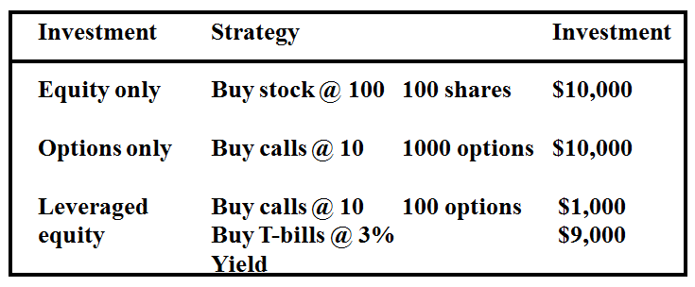
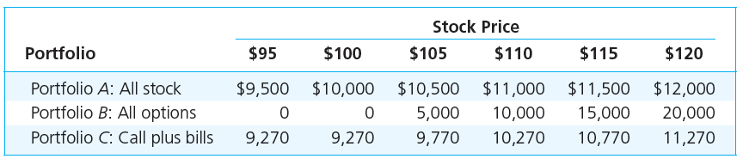
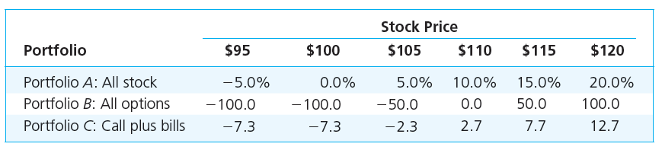
Option vs. Stock Investments

Slide 28
Strategy Conclusions
The all-option portfolio, B, responds more than proportionately to changes in stock value; it is levered.
Portfolio C, T-bills plus calls, shows the insurance value of options.
C ‘s T-bill position cannot be worth less than $9270.
Some return potential is sacrificed to limit downside risk.

Slide 29
Options vs. Futures
The biggest difference between options and futures is that option purchases have losses limited to the amount paid for the option, whereas futures have no effective limitations on losses.
For example:
an option to buy 100 shares of IBM stock on December 31, at an exercise price of $90 per share might sell for $500 ($5 per share). If the price per share of IBM is $90, $80, or $70 on December 31, the option expires worthless and the purchaser loses only the $500 price paid for the option. It makes no difference to the option holder how low IBM goes below $90, given the price is below $90.
In contrast, the purchaser of a futures contract on Treasury bonds at a price of $90 per $1000 face cares a great deal whether the price at expiration is $90, $80 or $70. If the futures contract expires at $90, the purchaser breaks even, if it is $80, she loses $10,000 and if it is $70, she loses $20,000.

Slide 30
Employee Share Option Plan
Employee Share Ownership People work better if they are working for themselves. Hence businesses that are owned by those who work in them are more likely to be successful than those owned by outsiders.
THE COMPANY Advantages
Align employees’ interests with those of shareholders;
Recruit or retain key employees;
Compensate for lower salaries and relieve pressure on cash flow;
Lower the supervision required of employees;
Increase innovation;
Increase shareholder value;
Motivate employees to become more productive;
Improve the communication between employee and managers;
Increase loyalty and reduce staff turnover;
Increase employee job satisfaction;
Increase the Company’s likelihood of survival;
Disadvantages
Where the share price of the company’s shares does not increase and the employee feels they have no control over the share price outcome, then it can affect morale and retention;
There are costs associated with establishment and administration of the ESOP;
Share Ownership, specifically option plans can be dilutive

Slide 31
Employee Share Option Plan
THE EMPLOYEE
. Benefits for Employees
Financial rewards, linked to individual and organizational;
An increased sense of ‘ownership’ and association with the enterprise;
Improved awareness about the ‘big picture’ decisions; directions and corporate plans of the enterprise;
Better partnership and communication between management and their employees;
ESOPs are often linked with employee engagement and involvement and this presents the opportunity to influence decisions about products and process.
Risks for Employees
Essentially the employee is over exposed to the company’s shares, so if the company does not perform or worse goes into administration the employees investment is lost;
The share price can decrease and this can impact the value of the holding for an employee;
The employee does not feel they can influence the share price and the plan has no value for them.

Slide 32
Thank you for the attention!
Any Questions?

